Slide 1

Iomair, iomair, iomair am bàta
Socair sìos an sruth
Notes:
Row, row, row the boat
Gently down the stream

Slide 2
Tha sinn sona, sona, sona
Tha sinn sona an-diugh
Notes:
We are happy, happy, happy
We are happy today

Slide 3
Iomair, iomair, iomair am bàta
Socair sìos an sruth
Notes:
Row, row, row the boat
Gently down the stream

Slide 4
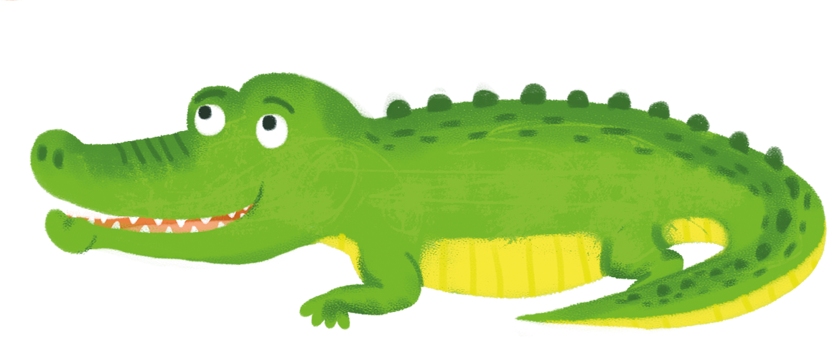
’s ma chì sibh crogall mòr
cuimhnich gun dèan sibh fuaim
Aaaaaaagh!
Notes:
If you see a big crocodile
Remember to make a noise
Aaaaaaaaagh!

